Slide 1
Project 5
Virtual Memory
INF-2201 Operating System Fundamentals
Spring 2023
Department of Computer Science
University of Tromsø

Slide 2
Operating system in P4
Kernel with preemptive scheduling.
System calls via interrupts.
Kernel threads run in ring 0.
Processes run in ring 3.
Processes are loaded dynamically.
Simple virtual memory scheme to provide isolated address spaces.

Slide 3
Overview of P5
You are going to implement virtual memory with swapping to disk.
Two-level page tables
Page fault handler
Physical page frame allocation scheme
Swapping to/from disk

Slide 4
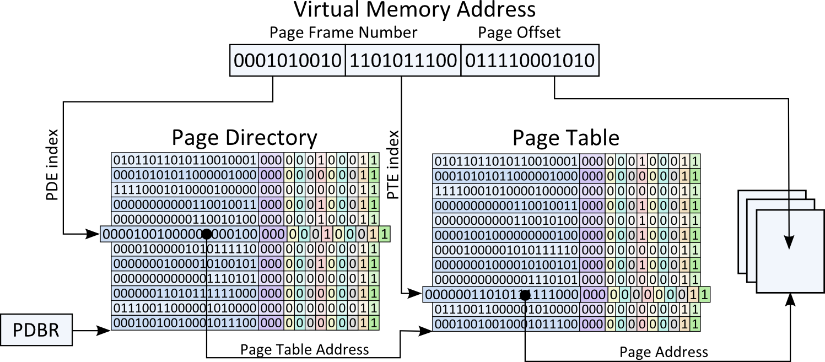
Paging on IA-32
4KB page size.
Specific bit in CR0 used to turn paging on/off.
Two-level paging
One top-level page directory
Page tables
32-bit virtual addresses split into
10 bits page directory index,
10 bits of page table index, and 12 bits of page offset

Slide 5
Paging on IA-32 (2)
Each page table contains information about 1024 4KB pages.
A page table is represented in a single, physical page.
Page Table Entry (PTE) = 4 bytes
One page table maps 4MB of virtual memory.
The page directory contains information about 1024 page tables.
Also represented by a single, physical page.
Page Directory Entry (PDE) = 4 bytes
Maps 4GB virtual memory address space.
Hierarchical
Don’t need to allocate all 1024 page tables in page directory!
Don’t need to allocate all 1024 pages in page table!
Present bit.

Slide 6
Paging on IA-32 (3)
Page fault handler invoked when a page is not in memory (and in some other cases).
Translation lookaside buffer (TLB): cache for page table entries.
Is not updated and invalidated automatically when a PTE is changed.
For more details: PMSA book.

Slide 7
Virtual Paging
Each process has its own page directory and page tables.
What about threads? (Design review)
Page directory base register (PDBR) in CR3 is saved in PCB and restored at context switching time.
Done in pre-code.
All processes must map kernel to the same virtual address range.
Why? (Design review)

Slide 8
Setup page tables for process
Allocate a physical page for page directory.
Identity-map all kernel pages.
Allocate and pin physical pages for page tables when needed.
Set user access bit for video buffer page.
For a user process
Mark all pages belonging to process (code/data) as not present.
Allocate and pin a page for user stack.

Slide 9
Memory access (simplified)
When an address within a virtual page is dereferenced:
Must resolve virtual page address to physical page address.
MMU performs lookup in TLB to locate mapping.
If entry is found (hit), it contains physical page address.
On TLB miss, page directory is located from physical address in CR3.
If PDE corresponding to virtual page address is marked as present, it contains physical address of page table.
If PTE corresponding to virtual page address is marked as present, it contains physical address of page.
If PDE or PTE is not present, a page fault is generated.
PDEs and PTEs also contain access bits. Access fault will also result in page fault.

Slide 10
Page fault
When a page fault exception (vector 0x14) is generated by CPU.
Page fault linear address (PFLA) is stored in CR2.
Contains the virtual address that generated fault.
The following is pushed to the kernel stack:
SS:ESP (if fault came from ring 3, since TSS switches to kernel stack, and we must be able to restore user stack).
EFLAGS
CS:EIP
Error code
Then, page fault handler is invoked.
Pre-code defines this: exception_14_entry() in entry.S.
Calls exception_14() in interrupt.c.
Stores CR2 in current_running->fault_addr.
This, in turn, calls page_fault_handler(), which you are going to implement!
Note: page fault handler may be interrupted!

Slide 11
Page fault handler
Get a free physical page (PP)
Evict a random page in use if no free page available
Extra credits: better eviction algorithm.
Map the faulting virtual page (VP) to PP. Allocate a physical page for the page table if necessary. Mark PP as allocated to VP (for eviction later).
Read data into PP from process image.

Slide 12
Physical page allocation – if free pages are available
Extract a free page from the free list
Need this list (you must create and manage it).
Mark the page as allocated.
Return the page.

Slide 13
Physical page allocation – no free pages available
while (1) {
get a random physical page in use;
if (page not pinned) {
unmap the virtual page using the physical page;
write the physical page to the image file;
return the physical page;
}
}

Slide 14
Data structures for physical page allocation
Physical page status table
Indexed by physical page number
What information should be stored here?
(Design review)
Free-list
A linked list of free pages from page status table
Initially, all pageable pages are in free-list.

Slide 15
Extra credits
Better replacement policy
FIFO?
FIFO with second chance?
Other?
Dedicated swap area on disk
Don’t overwrite image file…

Slide 16
Hints
Use flush_tlb_entry() when necessary to make sure TLB does not contain outdated mappings.
When do we have to do this?
(Design review)
Double check your bit operations
Triple check your protection bits
Use helper function
You can use serial-I/F for debugging
Both on physical machine…
…and on Bochs

Slide 17
Design review, code, report, hand-in
As for P1 and P3

